Slide 1
Introduction to Data Science
With Case Studies

Slide 2
Presenter Introduction
My name is Mitali Singh
I have 1 year of experience with hands-on in Python
Currently working as a Data Analyst in Acadgild
Skilled in Python, Statistics and Machine Learning algorithms.

Slide 3
Participant’s Introduction
Name
Years of experience
Any programming experience
Organization where you work(optional)

Slide 4
Training Goals / Session Expectations
1. Data Science Introduction
2. Python, Python libraries
3. Statistics, Machine Learning
4.Concepts + Hands On
5.Software Installation:
○Anaconda - Jupyter Notebook
6. Case Studies
7. Project

Slide 5
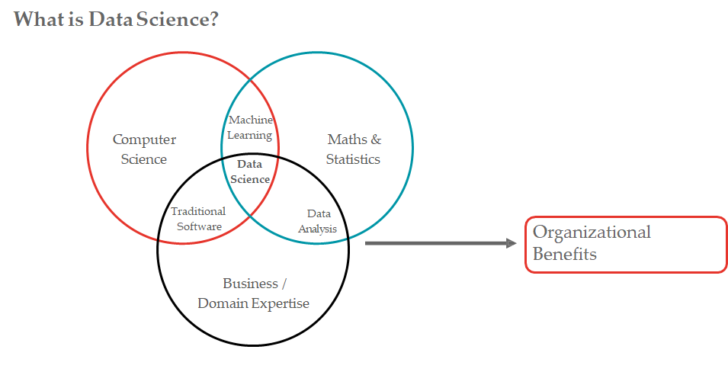

Slide 6
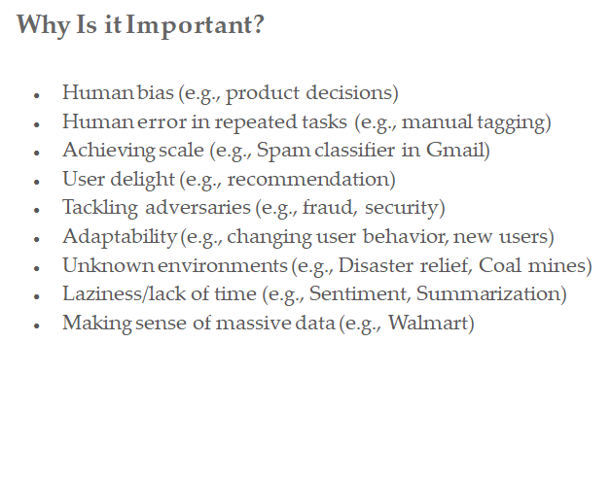

Slide 7
How does it impact businesses?
Pharmaceutical and Medicine:
Disease Diagnosis
Medical Image Analysis
Finance:
Fraud Detection
Credit Risk Assessment
E-commerce:
Recommender Systems
Marketing/Sales:
User Segmentation
Lead Prediction
Advertising:
User Behavioural Targeting
Automobile Industry:
IT
Fashion
Insurance
And many more..

Slide 8
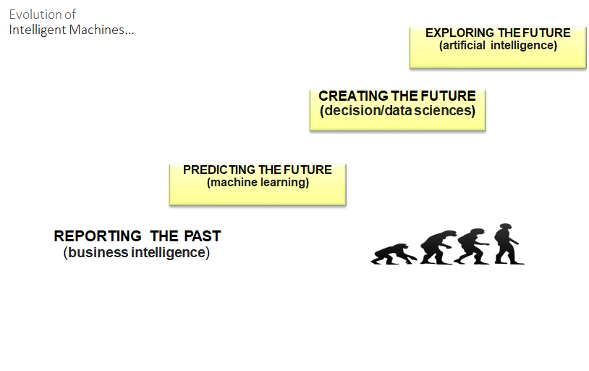

Slide 9
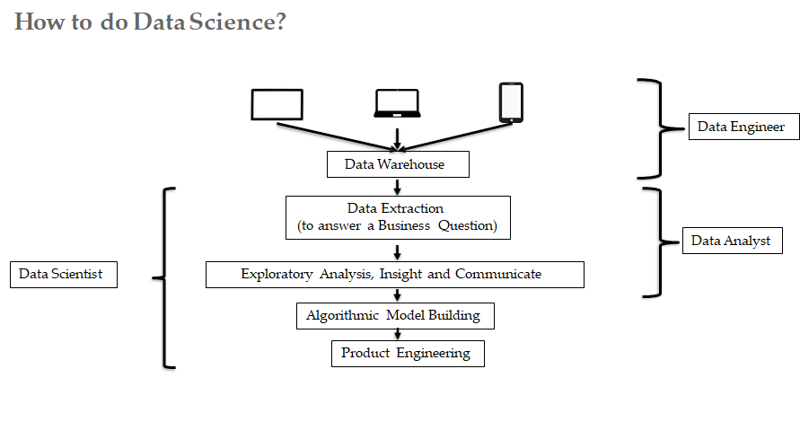

Slide 10
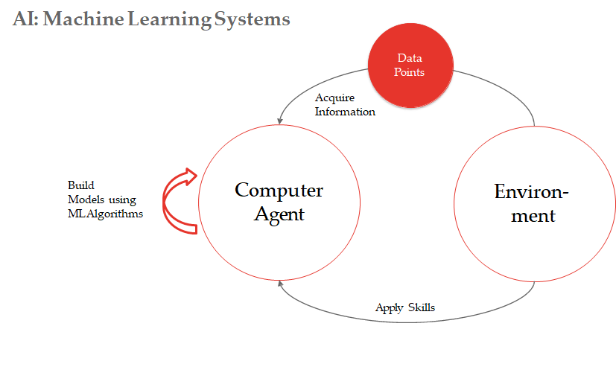

Slide 11
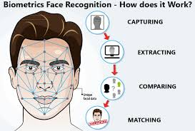
Case Study: Face Recognition
System
Applications of Face Recognition System
Unlock Mobile Phones
Identifying people on Facebook: Facebook uses face recognition technology to automatically recognize when Facebook members appear in photos.
Track Attendance
Security

Slide 12
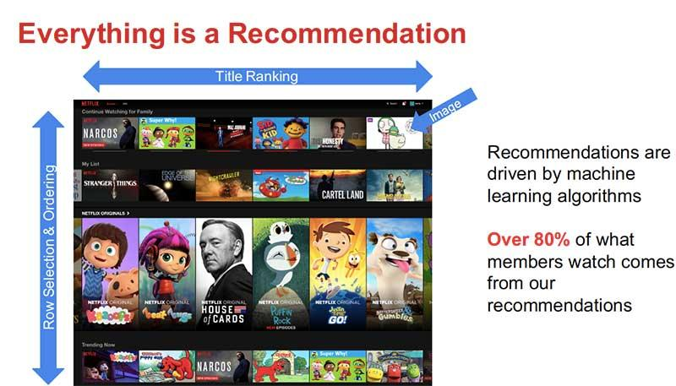
Case Study: Netflix’s
Recommendation System
Initially, a DVD rental service.
In 2005, realized the potential of combining :-
i.High Speed Internet Availability to masses
ii.Need for binge watch of content by consumers, at their own leisure
Came up with a subscription based streaming services in 2007, while gradually decreasing focus on DVD business.
For the next 5 years or so, while the streaming business thrived, Netflix captured huge amount of data (usage patterns and preferences of the users) from its streaming service.
During this time, Netflix keenly observed other trends like popularity of Game of Thrones on HBO (2011).
So when the US adaptation of British Mini Series House of Cards came up for grabs in 2013, Netflix acquired the distribution rights in a multi - million dollar deal. It was a first for Netflix at that time.
Netflix terms it as “Netflix Originals”.
The concept of “Originals” became an instant hit with HBO (and it’s Indian Partner hotstar) and hulu (The Handmaid’s Tale) imitating it.
Later on, Netflix integrated a Machine learning based algorithm-driven recommendation engine to prolong used subscriptions.
Link for more information

Slide 13
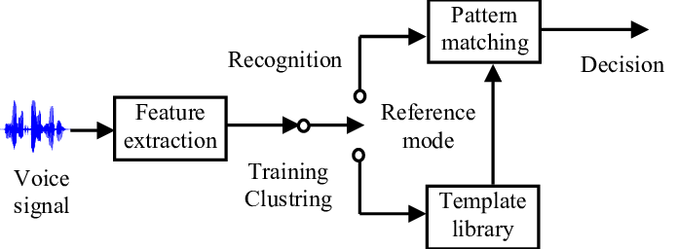
Case Study: Voice
Recognition System
Applications of Voice Recognition System
Amazon’s Alexa
Apple’s Siri
Google’s Google Assistant
Microsoft’s Cortana

Slide 14
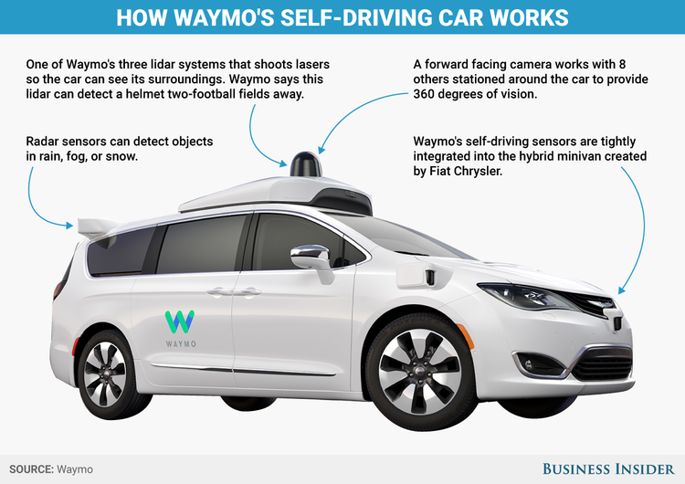
Case Study: Self-Driving
Car(Waymo)
Google’s project which hived into a separate entity
What does it do ?
Light detection and ranging: Using sensors such as radars, cameras etc, the vehicle are able to create a short-distance understanding of its surroundings in real time.
Mapping: The vehicle’s computer must possess and have the ability to process highly detailed, comprehensive maps of street features, including streetlights, signs, roads, and curbs.
Vehicle-to-vehicle communication: Made possible as cars are fitted with computers (having internet ? No Big Deal)
Sense-plan-act: In order to plan and act in timely fashion, the vehicle’s machine learning algorithms must be able to predict outcomes based on a high volume of data. It does exactly that to wade pass through different traffic scenarios.

Slide 15
Introduction to Python
Python is a popular programming language. It was created by Guido van Rossum, and released in 1991.
It is used for:
web development (server-side),
software development,
mathematics,
system scripting.

Slide 16
What can Python do?
Used on a server to create web applications.
Python can connect to database systems. It can also read and modify files.
Python can be used to handle big data and perform complex mathematics.
Python can be used for rapid prototyping(creating design pattern), or for production-ready software development.

Slide 17
Why Python?
Python works on different platforms (Windows, Mac, Linux, Raspberry Pi, etc).
Python has a simple syntax similar to the English language.
Python has syntax that allows developers to write programs with fewer lines than some other programming languages.
Python runs on an interpreter system, meaning that code can be executed as soon as it is written.
Python can be treated in a procedural way, an object-oriented way or a functional way.

Slide 18
The most recent major version of Python is Python 3, which we shall be using here. However, Python 2, is still quite popular.
Python uses new lines to complete a command, as opposed to other programming languages which often use semicolons or parentheses.
Python relies on indentation, using whitespace, to define scope; such as the scope of loops, functions and classes. Other programming languages often use curly-brackets for this purpose.
We are using the latest version of Python i.e., 3.7.2

